Slide 1
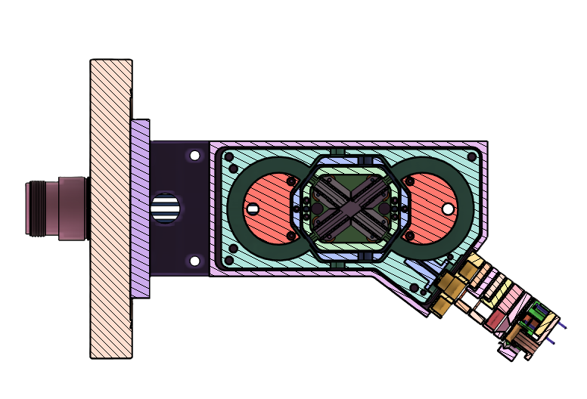
Racetrap V2
24/09/2026

Slide 2
Recap
The first Racetrap version failed to trap ions due to:
  Oversensitivity to misalignment (confirmed in simulation)
  Mechanical design with too many degrees of freedom for possible misalignment
The second Racetrap version included:
  Increased ΔR to lower the sensitivity to misalignment
  Joined Inner and Outer electrodes to decrease possible misalignments
  Improved grounded shielding
  Differential detectors

Slide 3
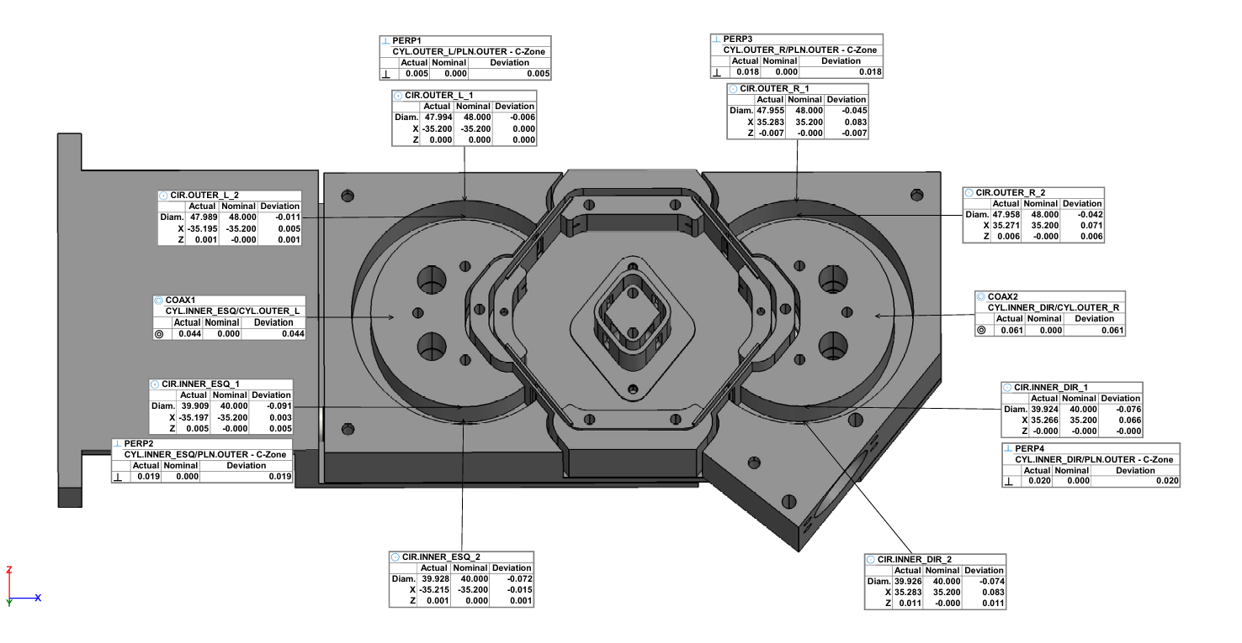
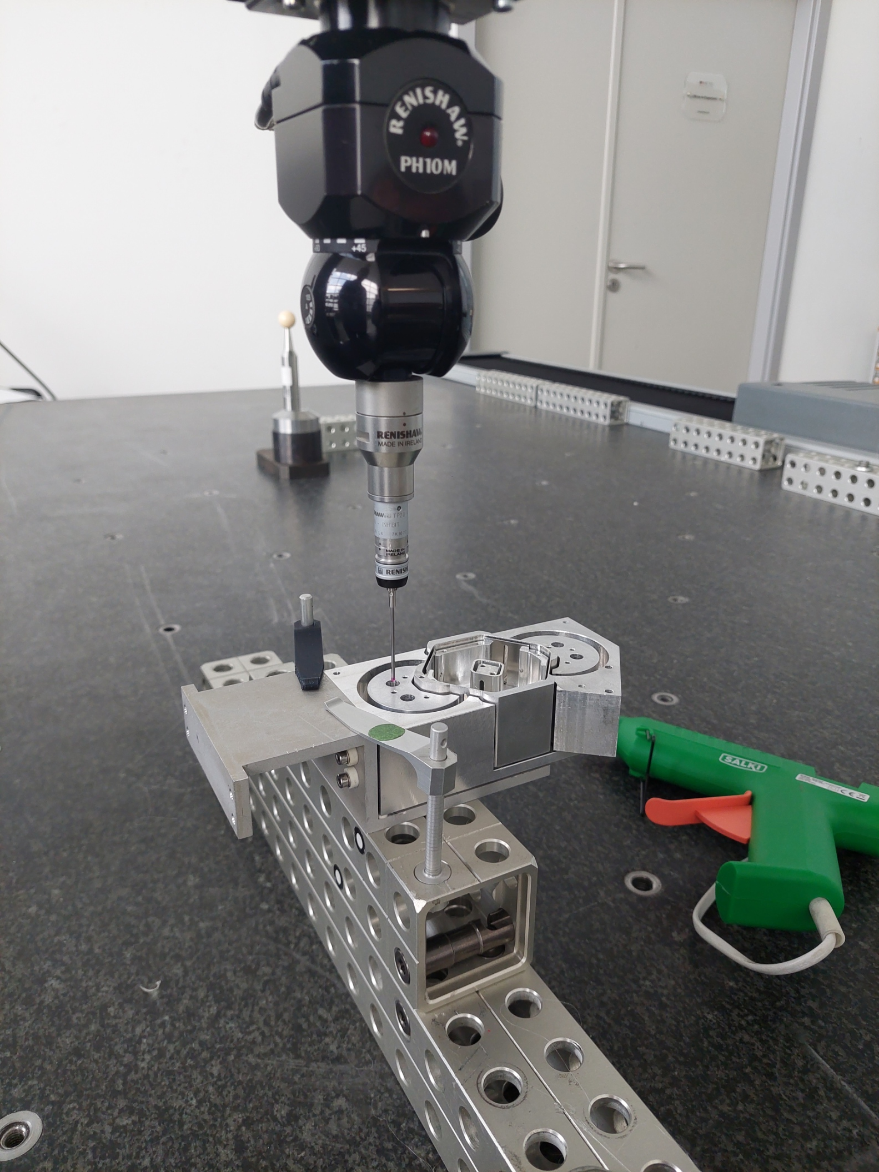
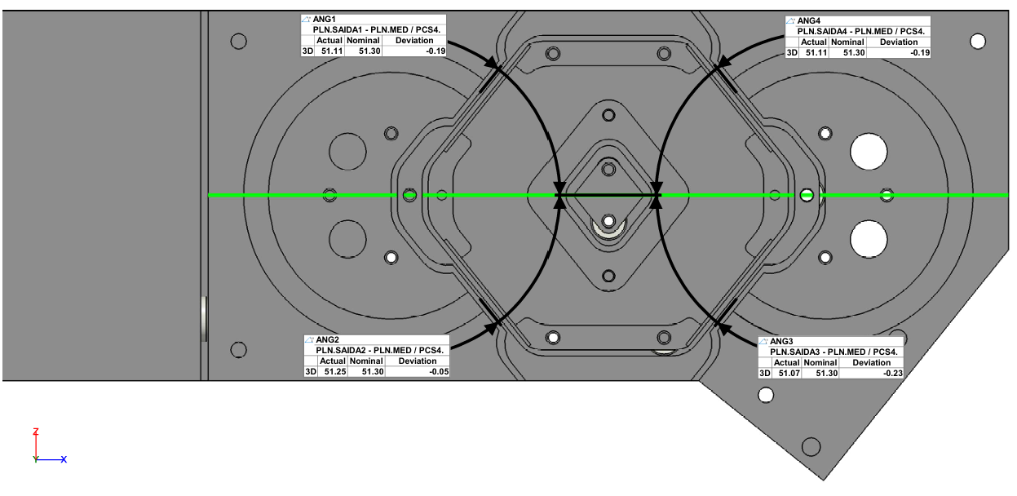
Measurement – previous version

Slide 4
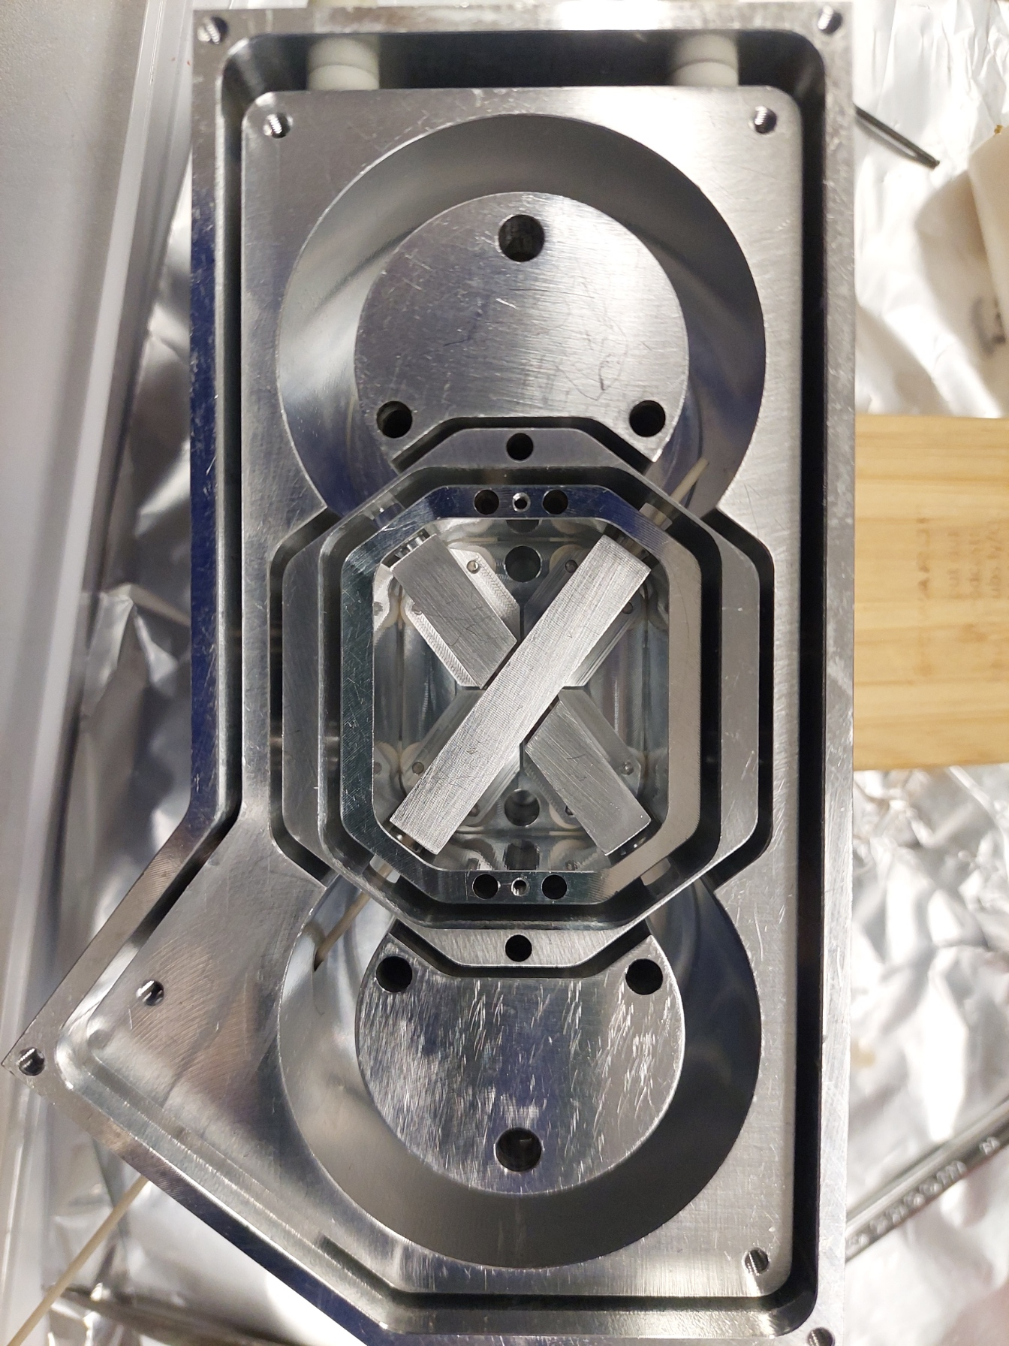
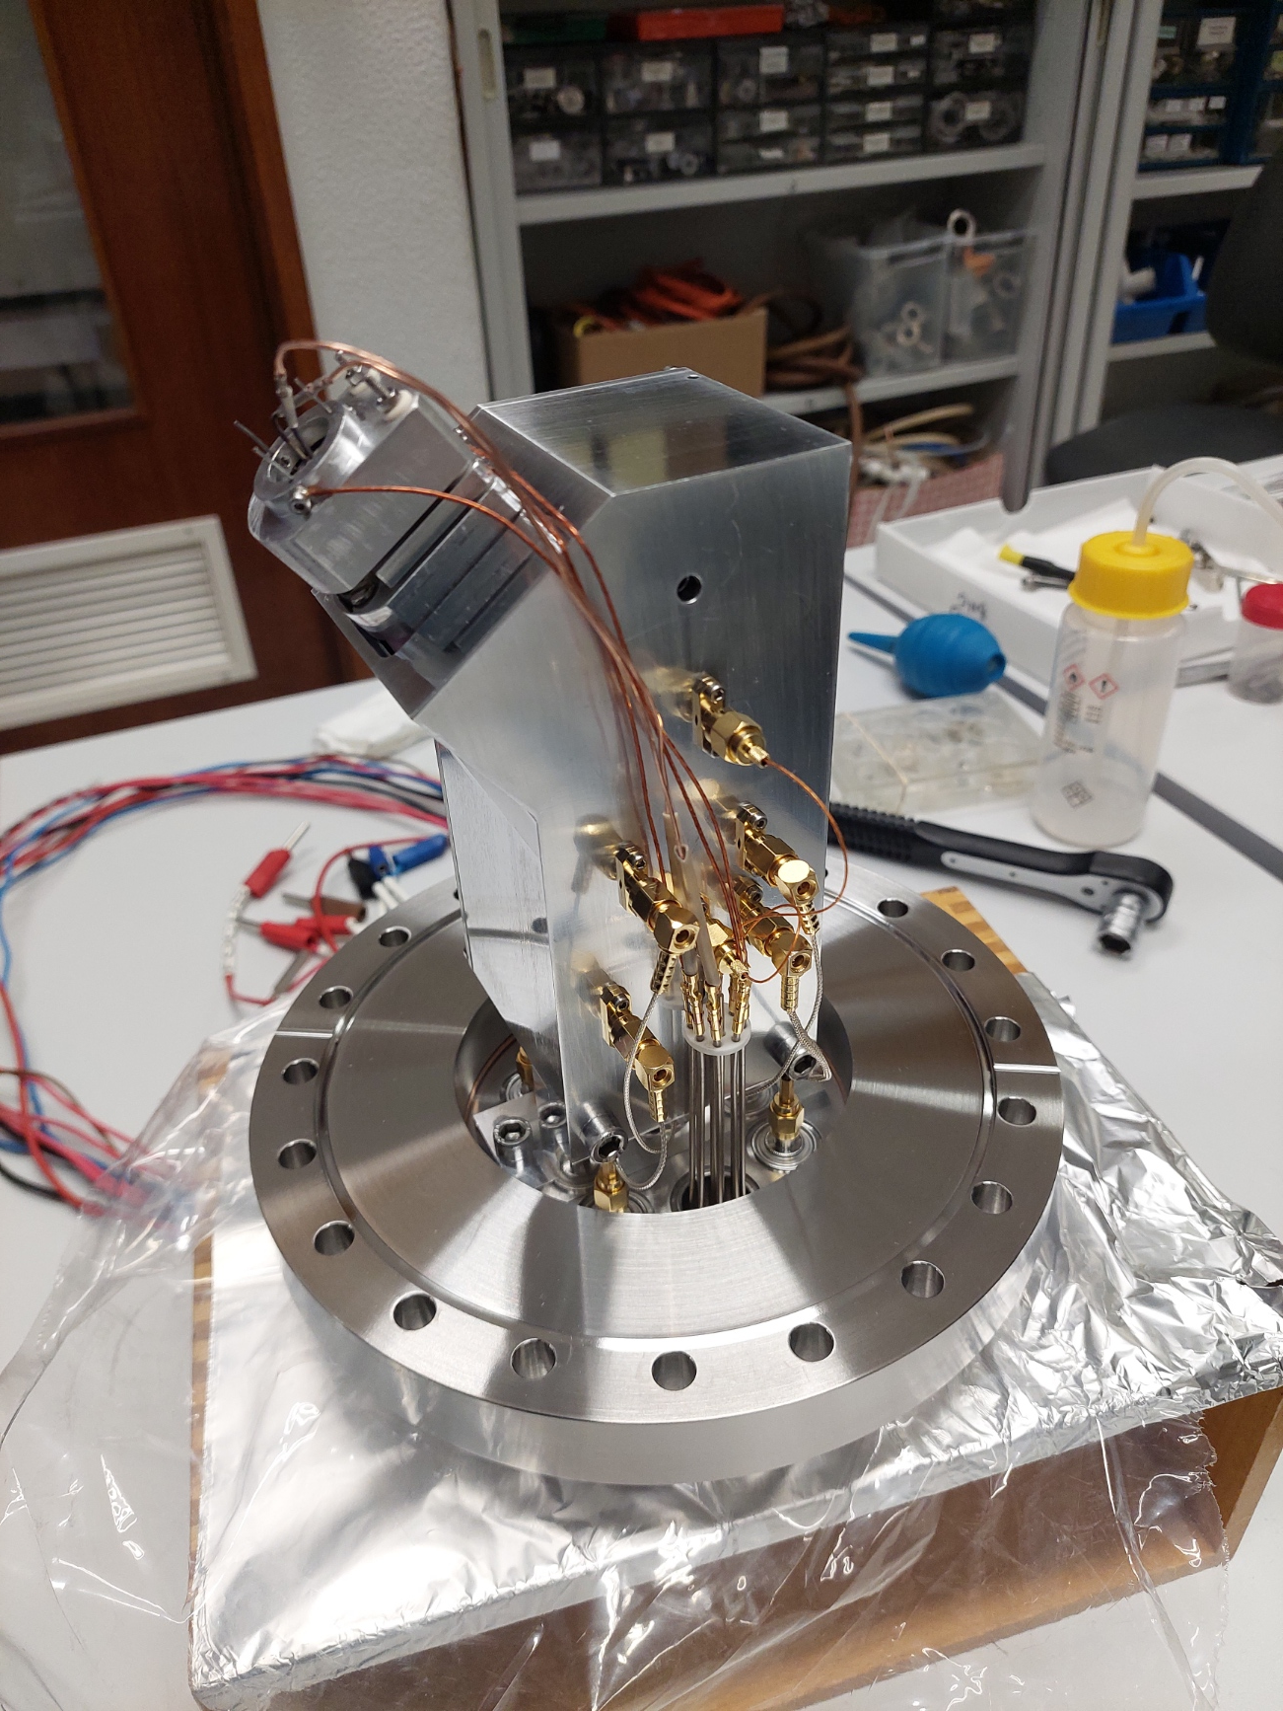
Second Racetrap Version
Na ion source
The second Racetrap version included:
  Increased ΔR to lower the sensitivity to misalignment
  Joined Inner and Outer electrodes to decrease possible misalignments
  Improved grounded shielding
  Differential detectors
  Alignment with calibrated 5.000 mm pins and 7.995 mm and 8.010 mm to probe the ΔR gap

Slide 5
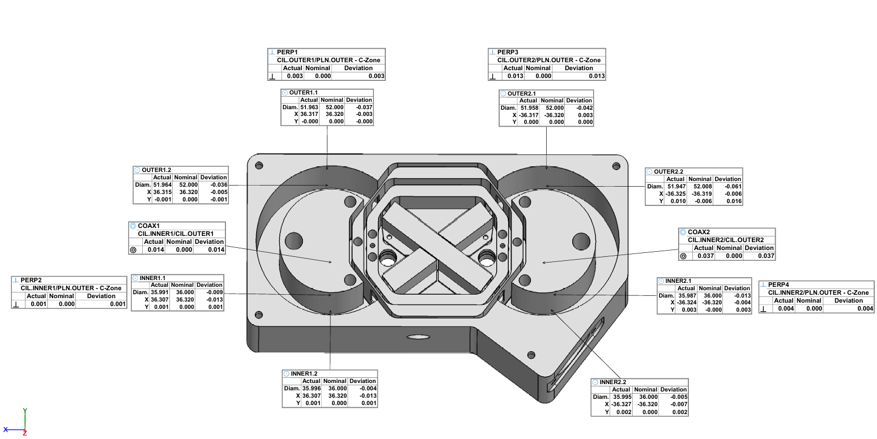
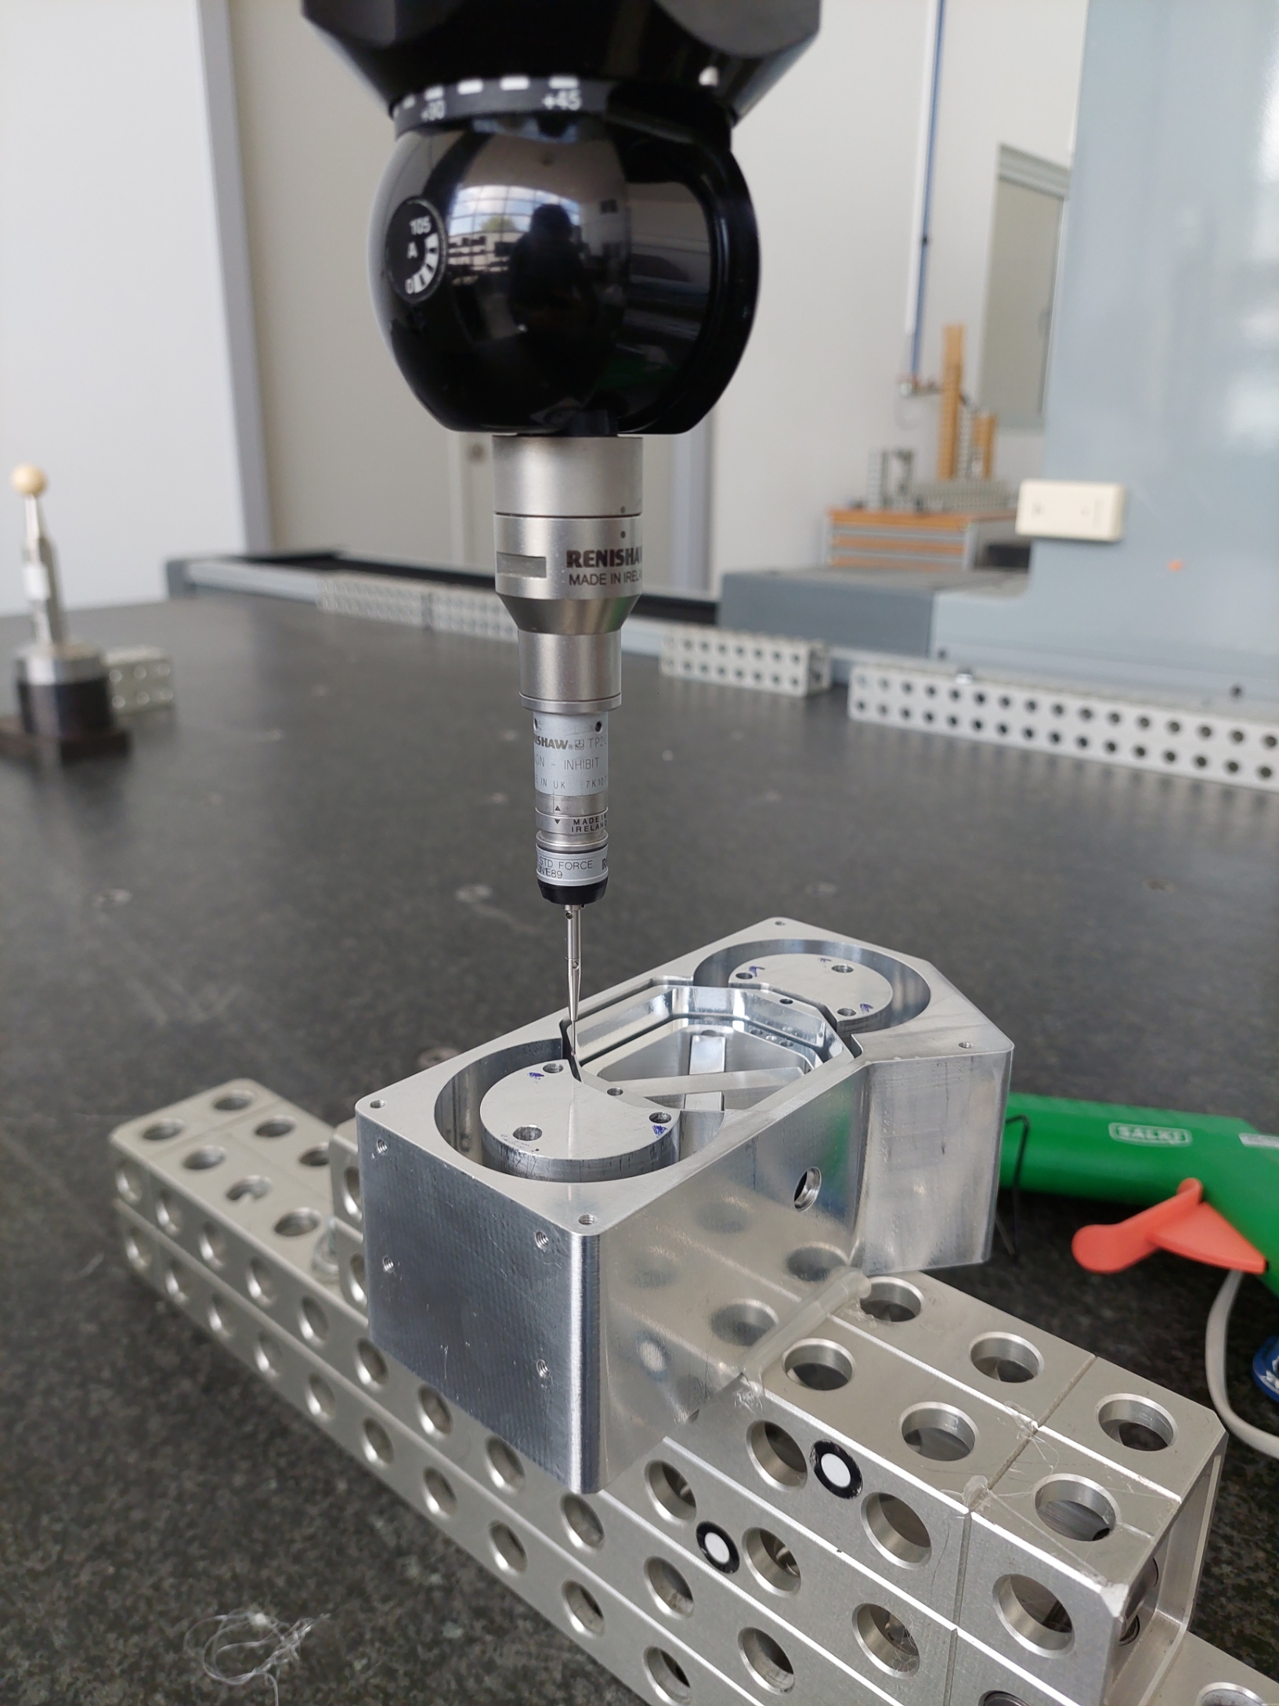
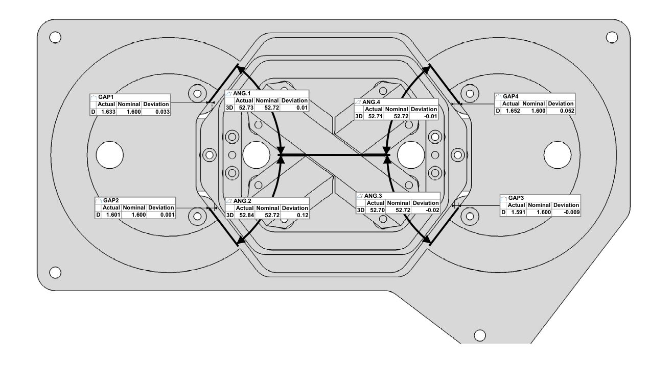
Measurement – second version

Slide 6
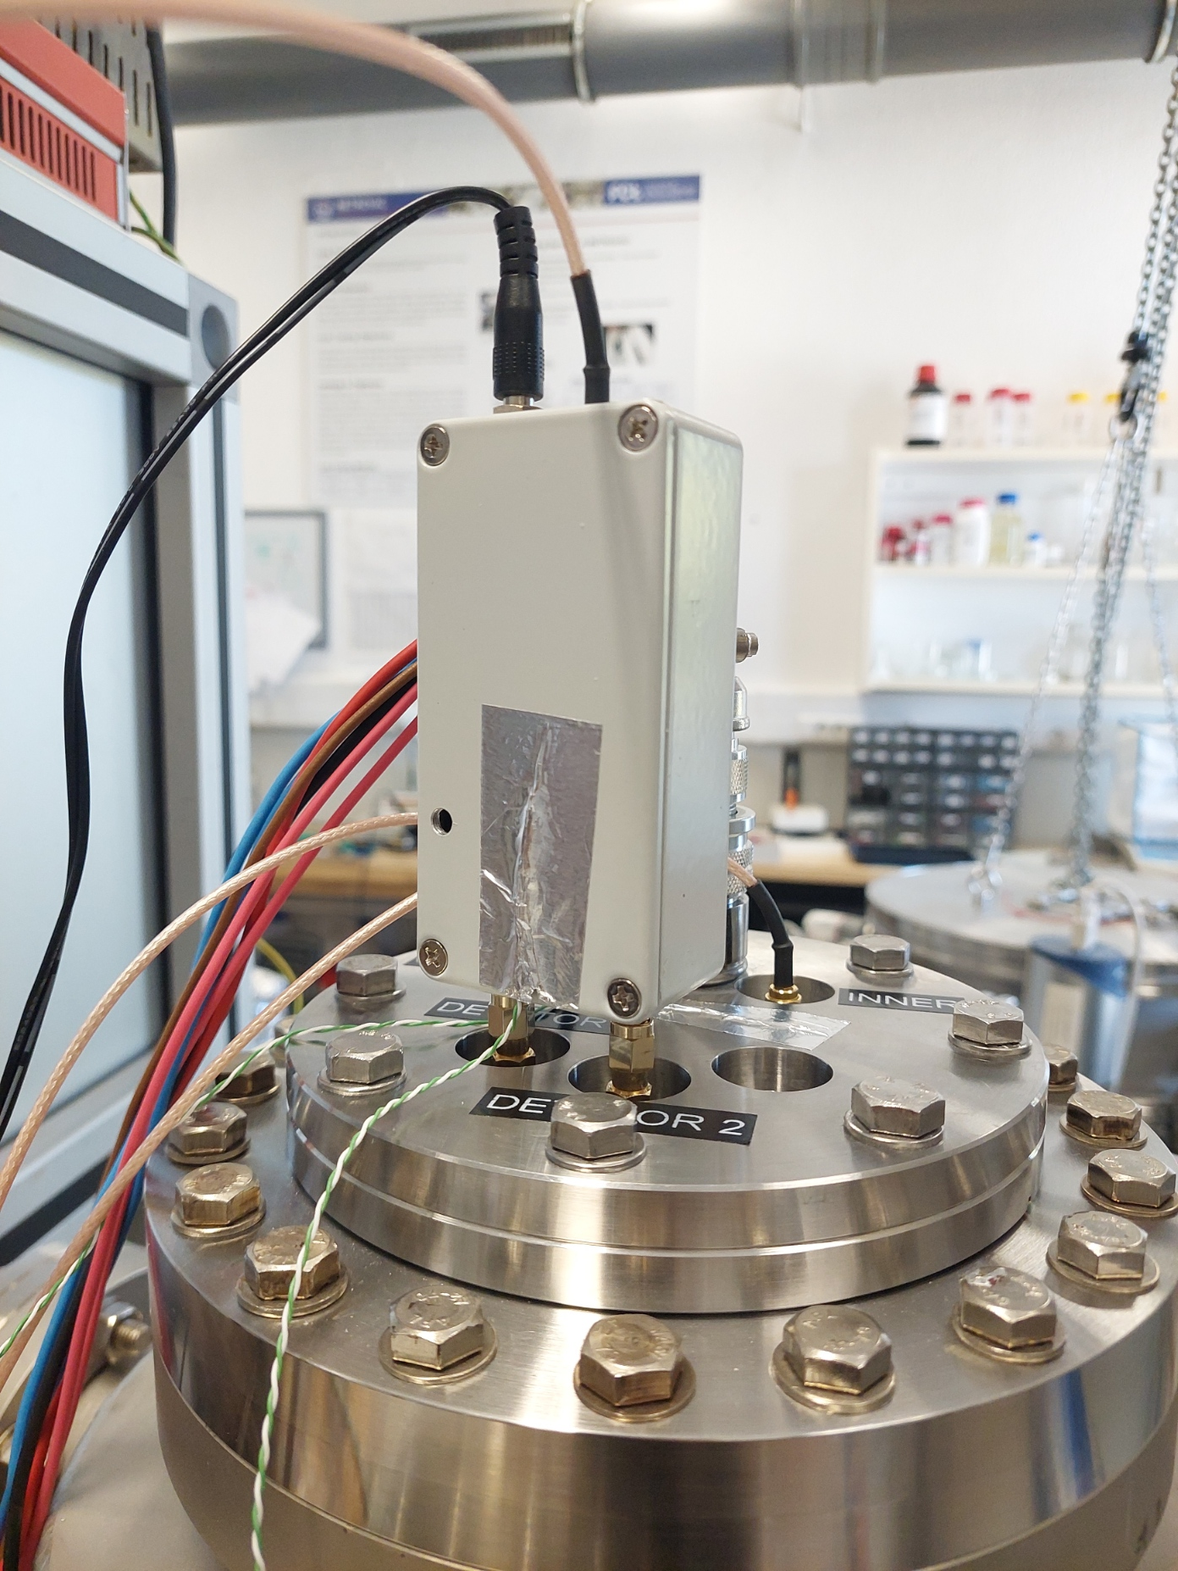
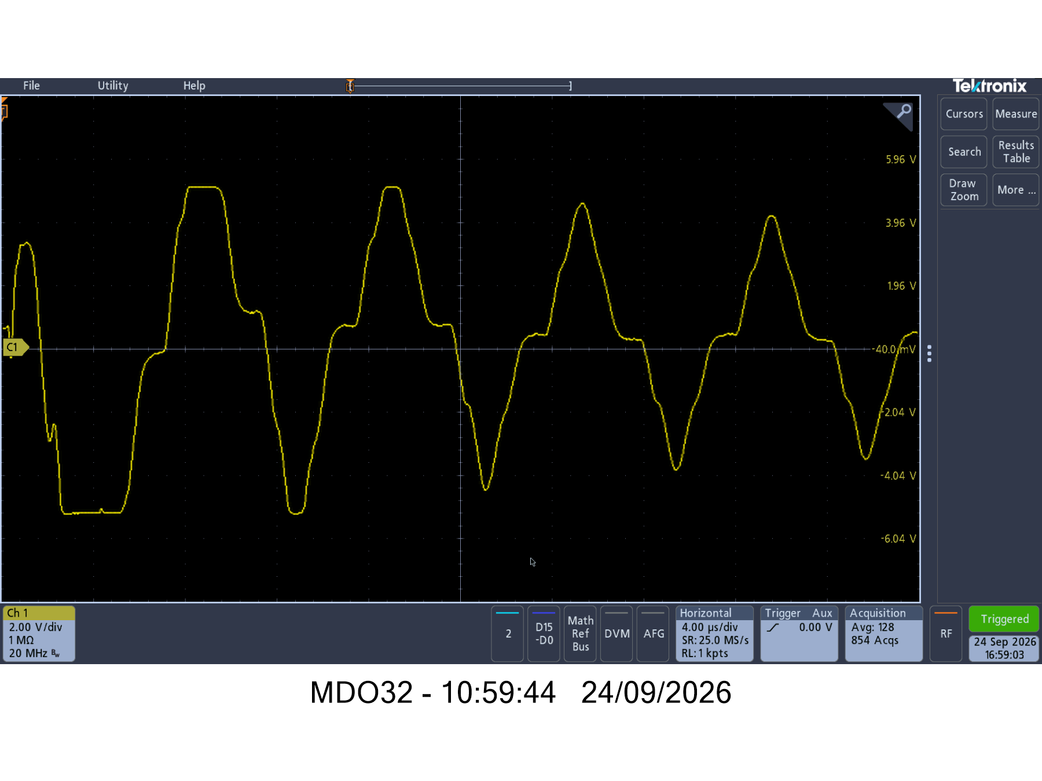
Differential detector
CF100

Slide 7
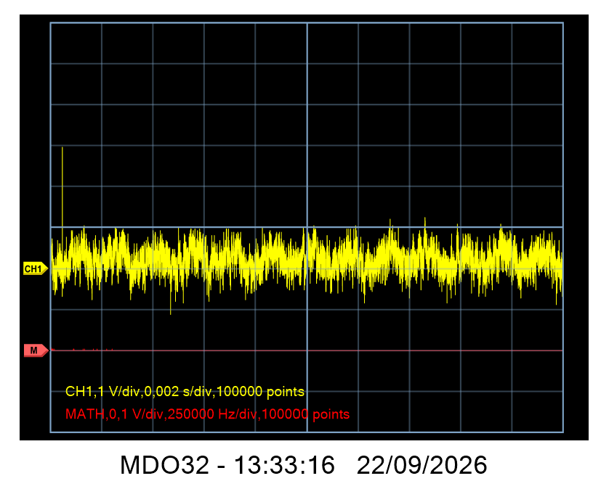
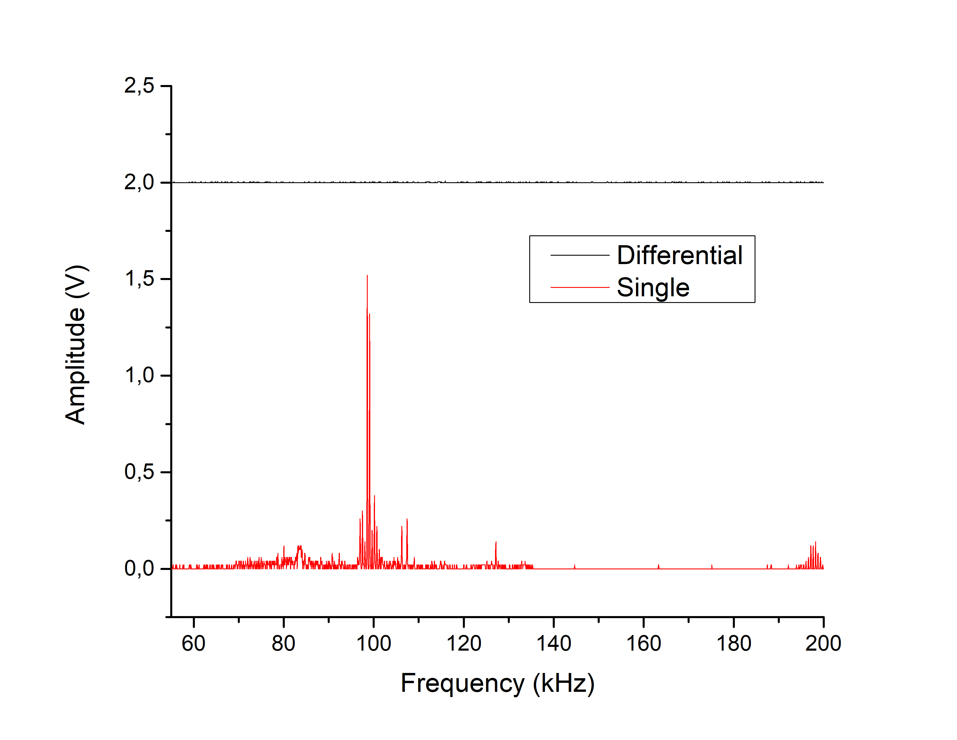
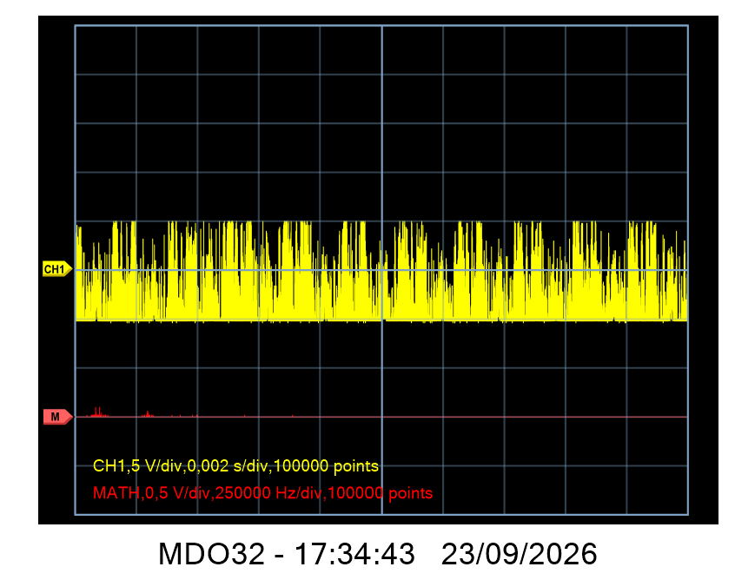
Differential detector vs Single detector noise level
Detector and CSPA 10 single acquisitions | Average RMS [V] | Standard deviation[V] | Equivalent Noise Charge [e RMS]
Differential | 1.057148336e-01 | 1.059712259e-03 | 440.48
Single | 2.393122484e+00 | 1.675075112e-02 | 9971.34
Differential detector
Vpp = 1.5V
Single detector
Vpp = 3V

Slide 8
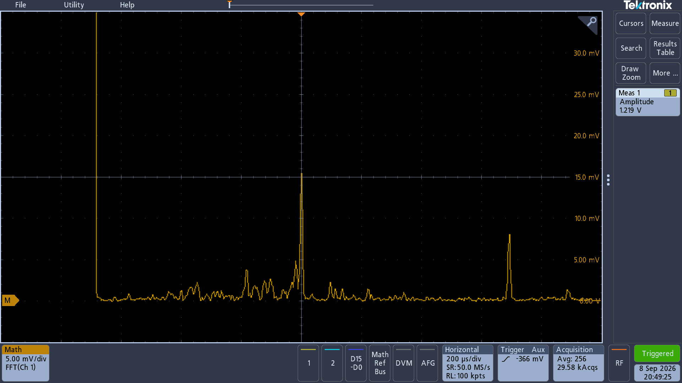
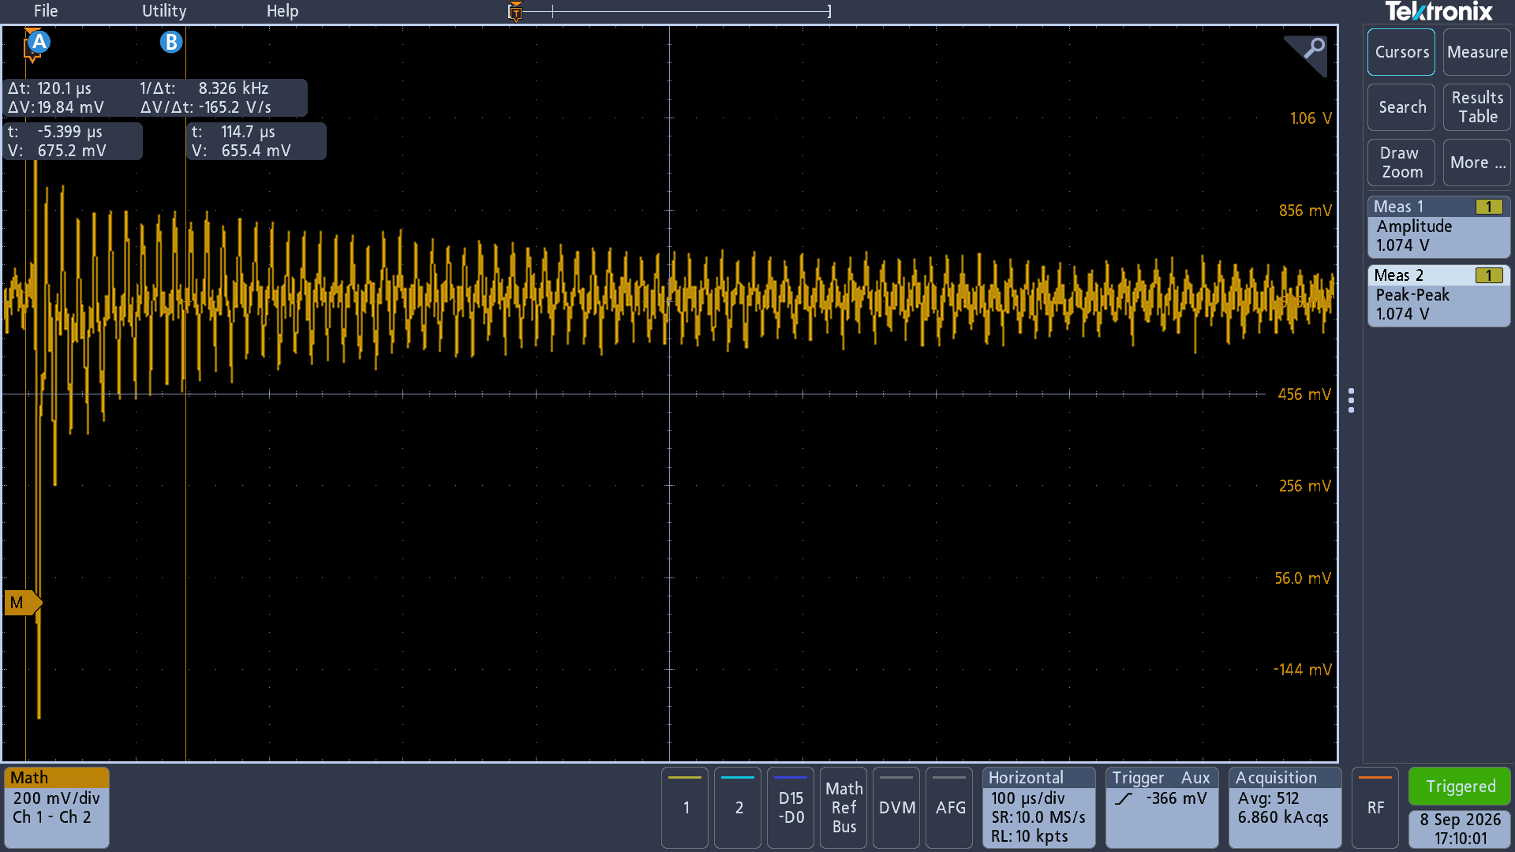
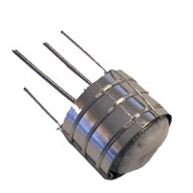
Experimental Results
Aluminosilicate Ion Source - Na
~50nA
Ion energy 100 eV
https://www.cathode.com/i_alkali.htm

Slide 9
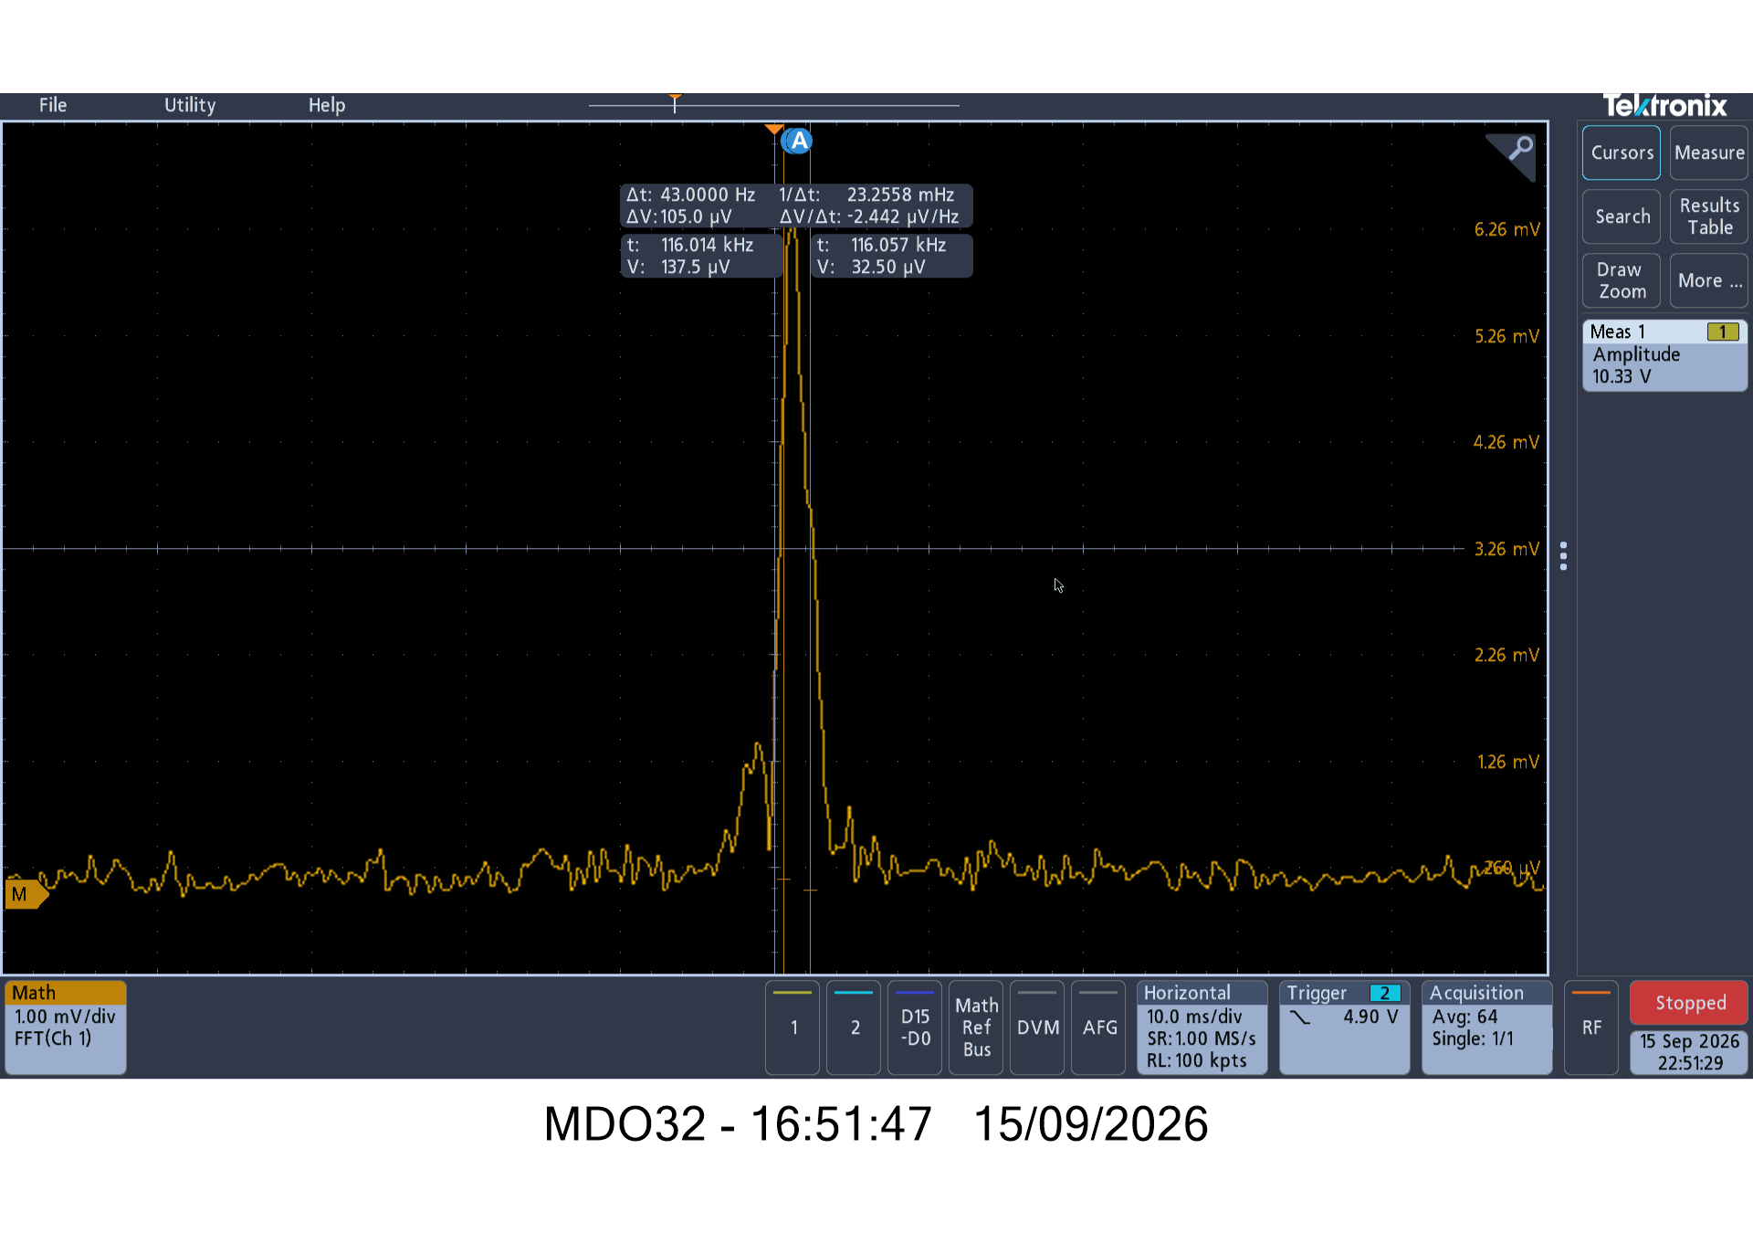
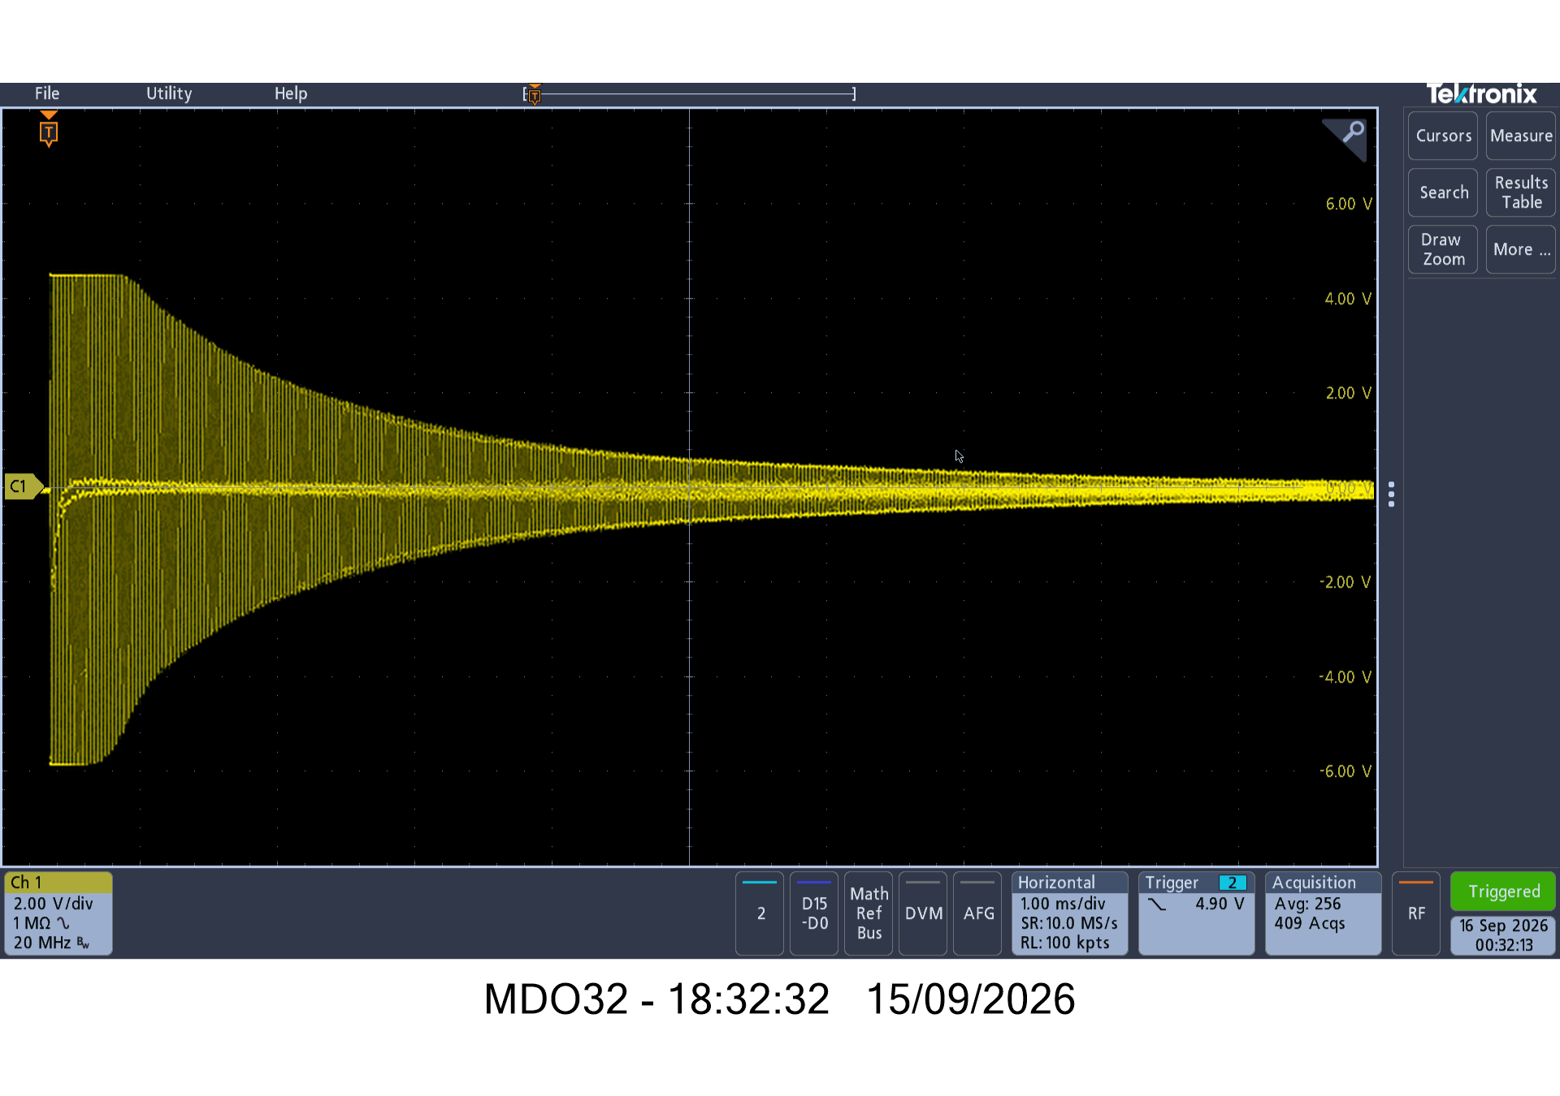
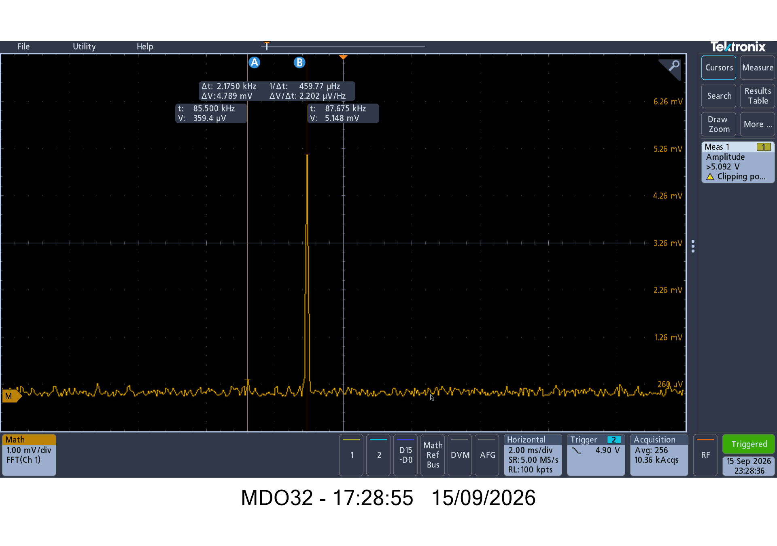
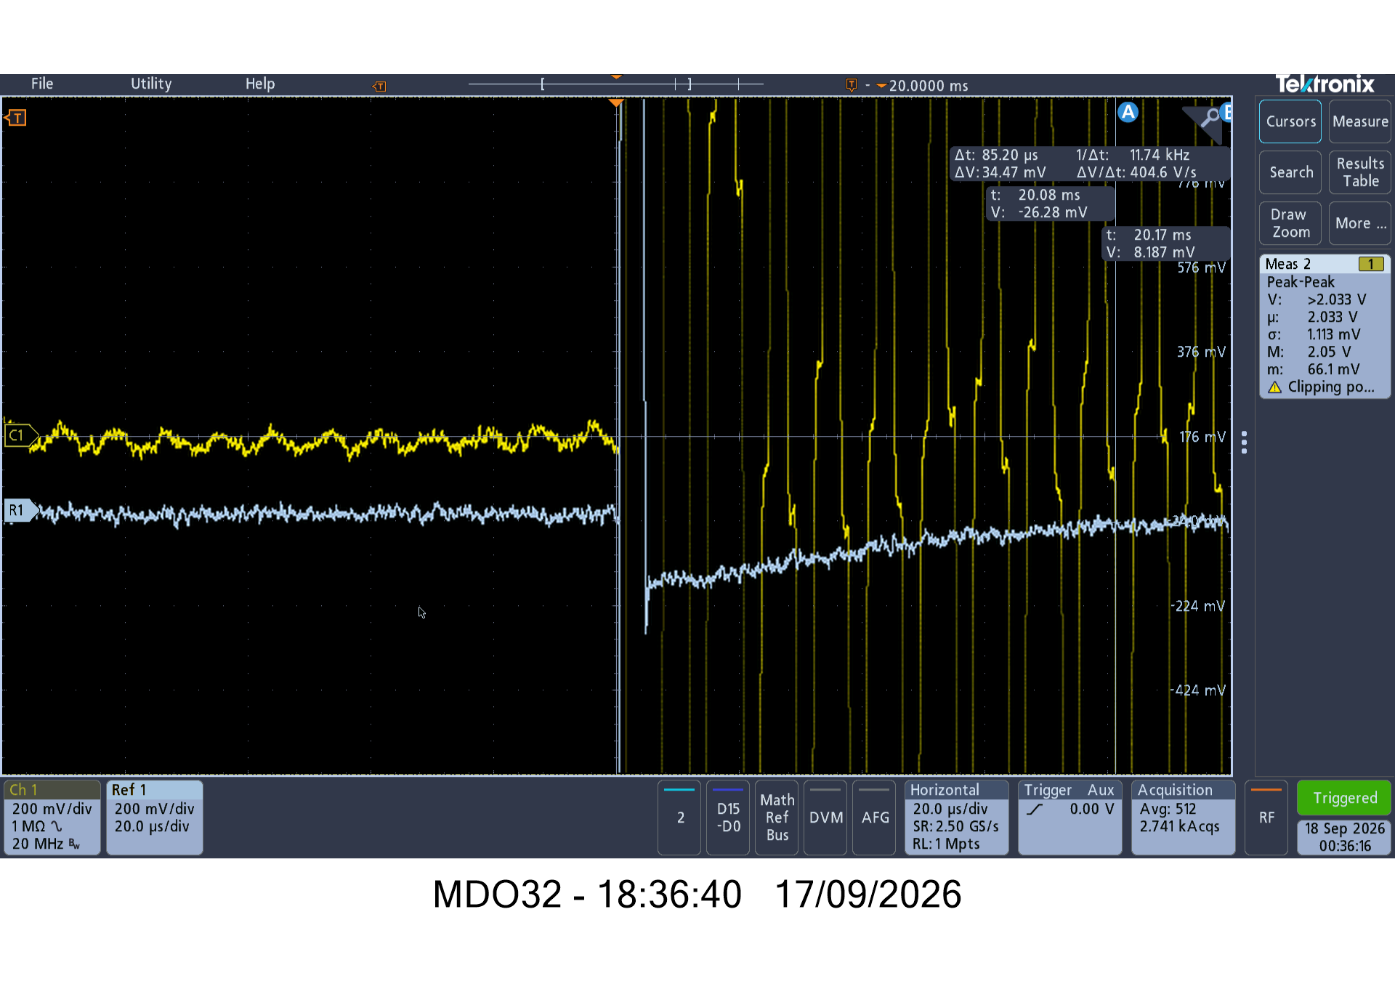
Increased ion energy to 200 eV
FWHM ~ 50Hz
f/Δf = 116/0.05=2320
Transmission decreasing to ~20% (up to 55%) (100 turns)- the alignment is not perfect
Corresponds to 4.2 elementary charges
Simulation: transmission decreases to 70% within 100 turns with perfect alignment
Stable ions at t= 20ms!
Background
Increasing the ion energy increases both the stability and the number of turns

Slide 10
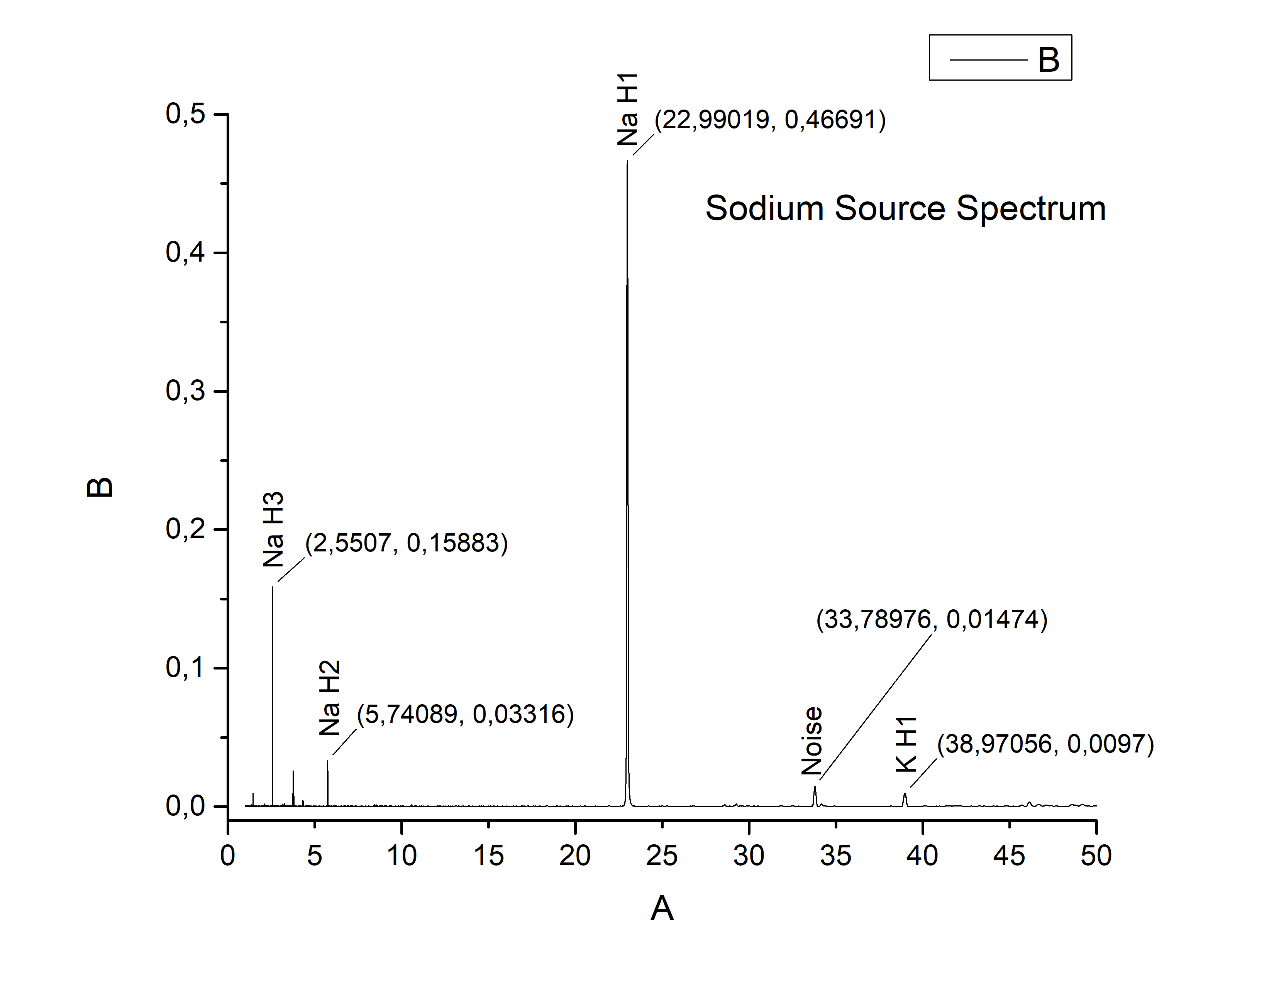
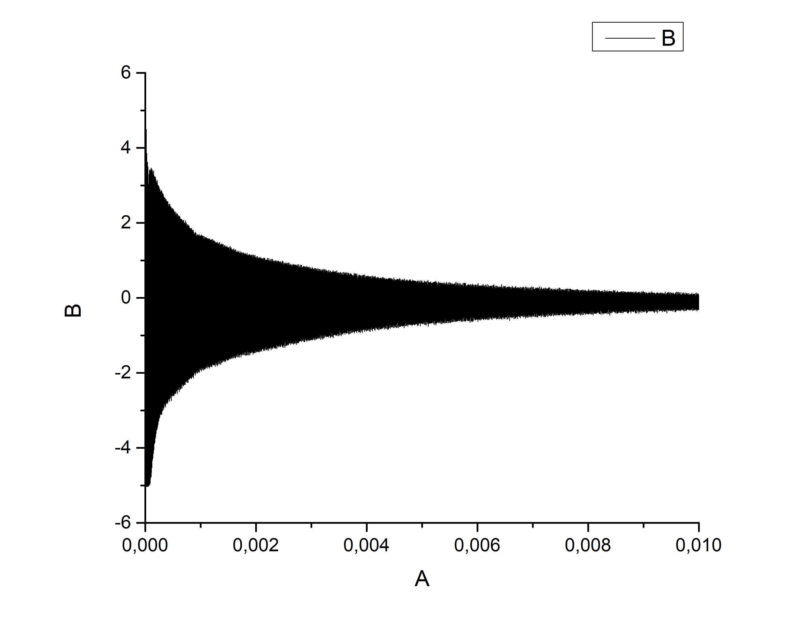
Mass spectrum
FWHM ~ 0.08 m -> m/Δm = 300
FFT with python, Blackman-Harris window; 10 ms time window

Slide 11
Major achievements
Ions are trapped in stable trajectories more than 20ms (2000 turns)
Differential detection improves the signal to noise ratio significantly
New double Charge Sensitive Preamplifier allows for gain adjustment
Frequency resolution of 2000 is still limited by the acquisition time, not by the physics of the trap
Dynamic measuring range from ~500 uV to 5 V (10000) with averaging.

Slide 12
Next Steps
Verify mechanical alignment after operation
Identify noise sources and improve signal-to-noise ratio
Implement mechanical alignment mechanism that is more rigid
Electronics – new switch with adjustable entrance potentials
Explore residual gas ion sources
Lower the chamber pressure – new turbo and getter pumps, baking, etc.
Improve signal post-processing
Introduce dedicated acquisition system with digitizer, pulse generation and standalone signal processing
Prepare IP protection

